Slide 1


Load Testing .NET APIs with K6
Hi everyone, my name is Rafael Franco, I’m 35 years old, married to Jovana Menezes, and a proud father of two. My family is my foundation and the reason I strive to build with purpose.
I hold degrees in Information Systems and Computer Science Education, and a postgraduate specialization in Project Management. I am certified in various technologies.
I have over 10 years of experience in the financial industry, including at XP Inc. in Brazil, where I helped develop their credit card platform and Luxoft, Coremont company..
by Rafael Franco

Slide 2

Introduction to K6
K6 is an open-source load testing tool for developers. It assesses system performance by simulating real-world traffic.
Tests are written in JavaScript. K6 helps identify performance bottlenecks.
https://k6.io/

Slide 3

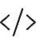



Why Choose K6?
JavaScript Scripting
Write tests using JavaScript, a familiar language for many developers.
CI/CD Integration
Integrate easily into CI/CD pipelines for automated testing.
Lightweight and Fast
Efficient and quick execution ensures rapid feedback.
Command-Line Based
Great for automation and scripting.

Slide 4
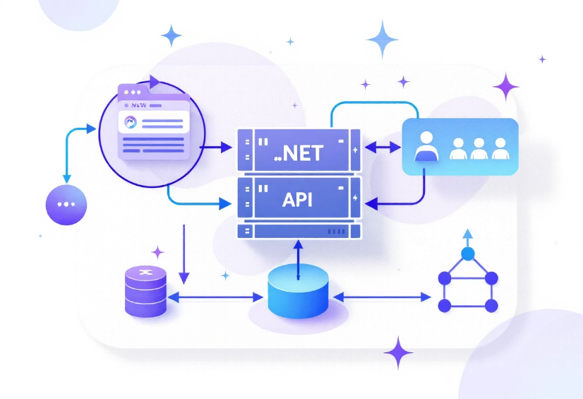
Proof of Concept Overview
This PoC uses K6 to load test a .NET API. It simulates concurrent users.
The goal is to validate response times and ensure API stability under load.

Slide 5

Prerequisites
npm install -g k6
cd api/ApiExample
dotnet run
First, install K6 globally using npm. Then, navigate to the API directory. Finally, run the .NET API. The API starts on http://localhost:5113.

Slide 6



Running the Load Test
Navigate to K6 directory
Execute K6 command
k6 run index.js --vus 3 --duration 10s
Run the test using the command line. VUs simulate 3 virtual users. The test runs for 10 seconds. index.js is the test scenario entry point.

Slide 7

index.js Overview
import weatherForecast from './scenarios/weather-forecast.js'; import { group, sleep } from 'k6'; export default () => { group('Endpoint Get Statements', () => { weatherForecast(); }); sleep(1); // simulate user think time };
This file imports the test scenario. It groups requests and simulates user think time. weatherForecast() executes the API test.

Slide 8

weather-forecast.js Highlights
import http from 'k6/http'; import { check } from 'k6'; import { CONFIG } from '../config.js'; const url = `${CONFIG.BASE_URL}/WeatherForecast`; const params = { headers: { 'Authorization': `Bearer ${CONFIG.TOKEN}`, 'Accept': 'application/json' }, }; const res = http.get(url, params); check(res, { 'max duration is 1s': (r) => r.timings.duration < CONFIG.LIMIT_TIME_DURATION, 'status is 200': (r) => r.status === 200, });
This script defines API request parameters. It sets headers, authorization tokens, and checks response status and duration.

Slide 9
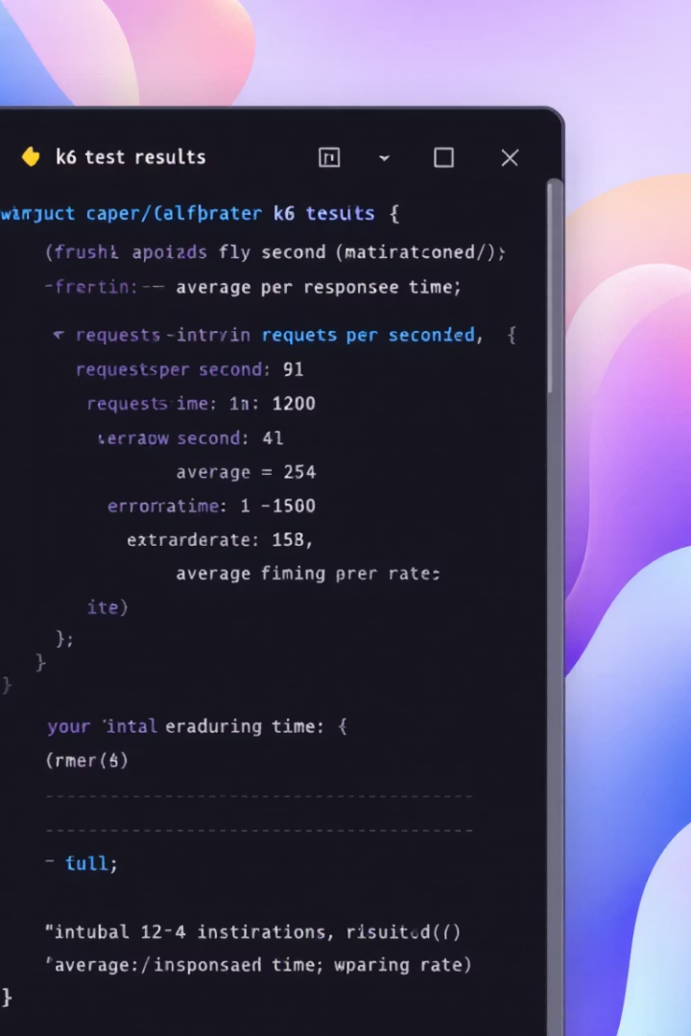
Sample Output
✓ status is 200 ✓ max duration is 1s http_req_failed................: 0.00% http_req_duration..............: avg=8.34ms iterations.....................: 30 vus............................: 3
The output shows key metrics. It confirms successful requests and durations. http_req_failed indicates request failures. http_req_duration shows average response time.

Slide 10

Result Highlights
Successful Requests
Fast Response Time
All requests returned HTTP 200 status codes.
Average response time was ~8ms.
Concurrent Users
No Failures
Simulated 3 concurrent users.
No failures were detected during the test.

